Slide 1

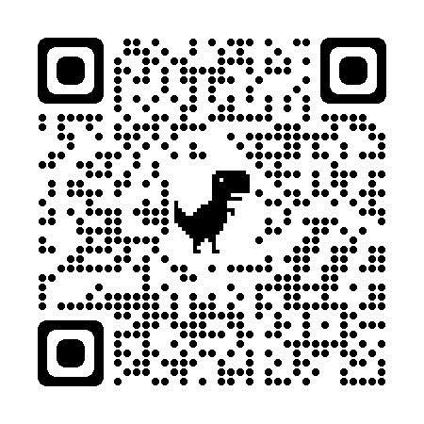
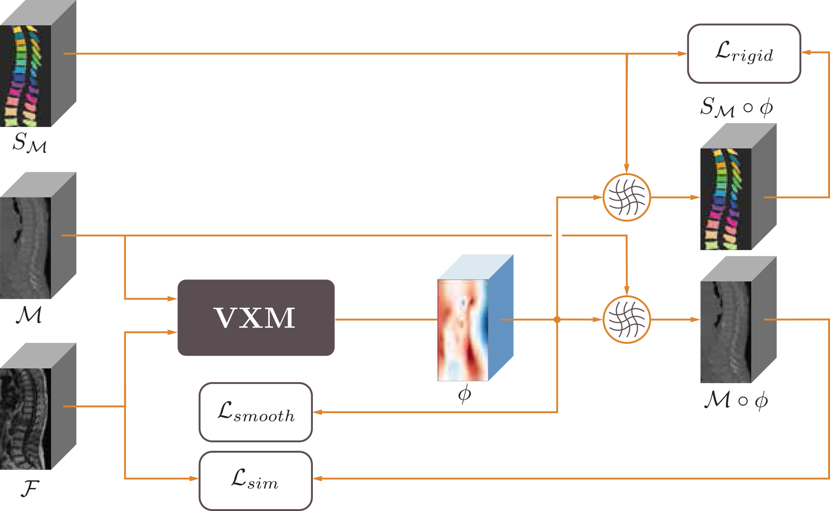
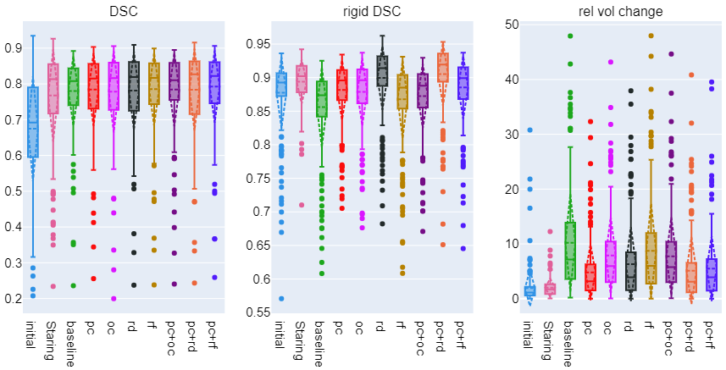
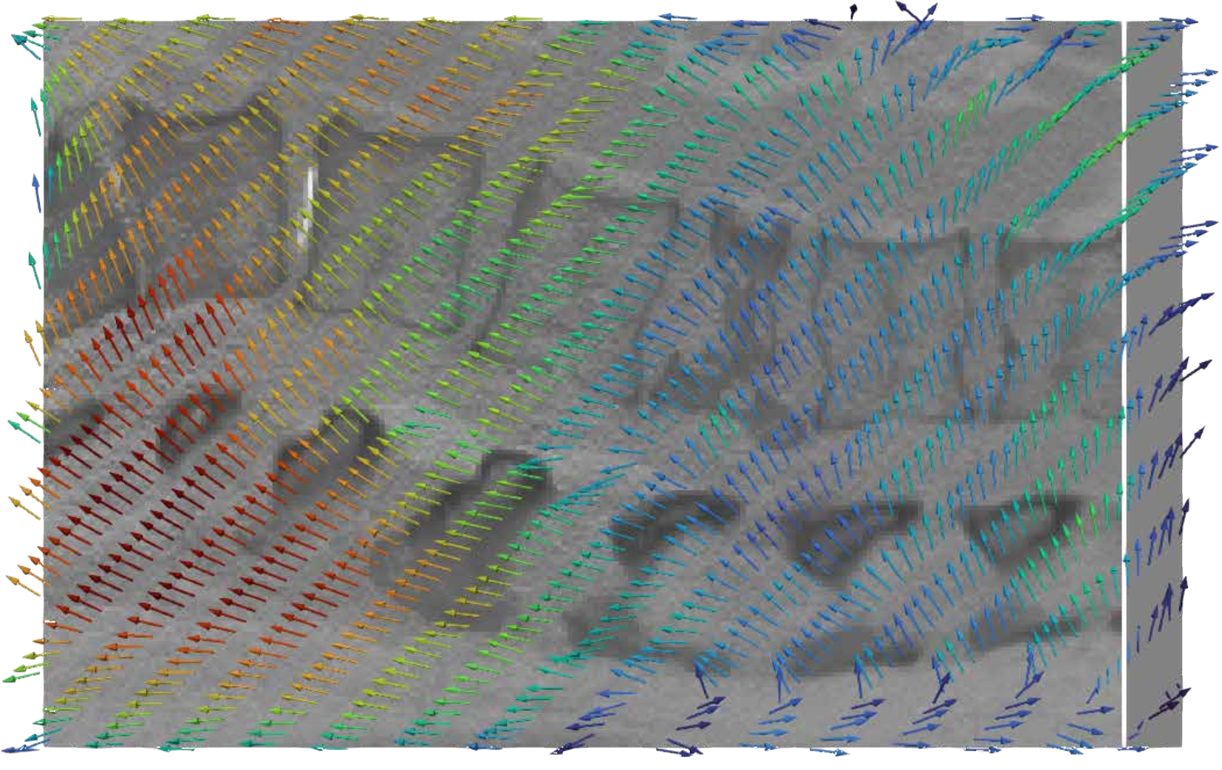
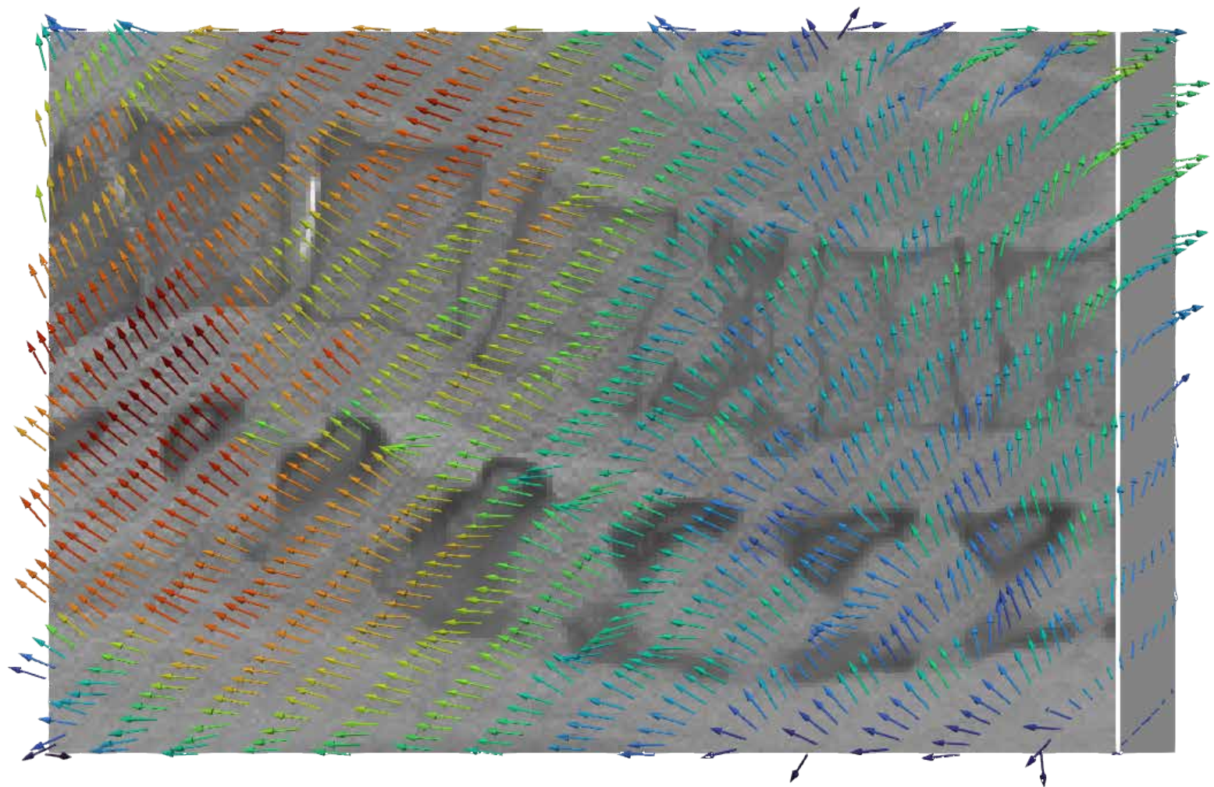
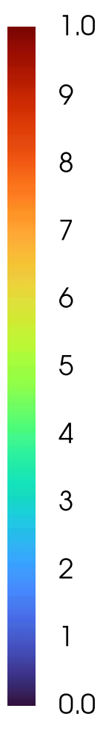
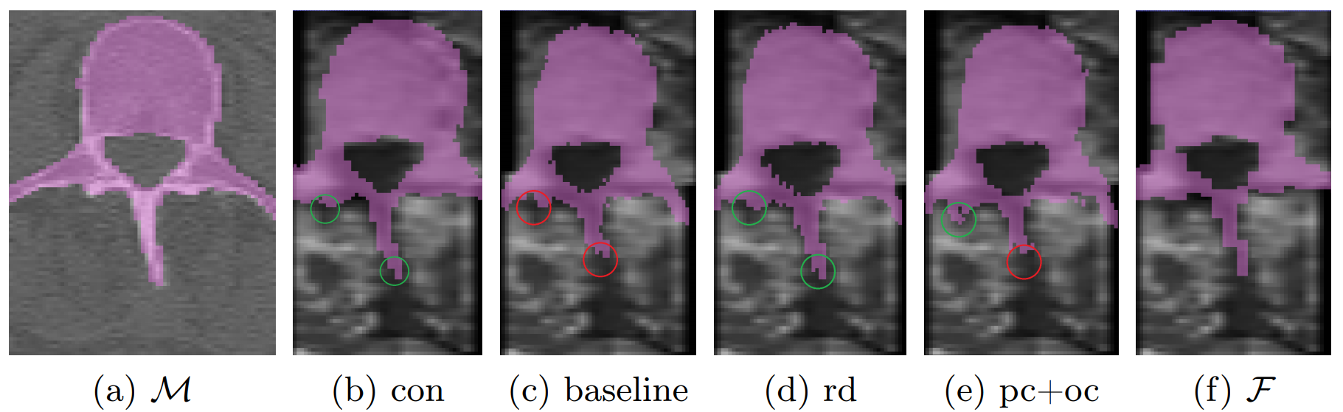
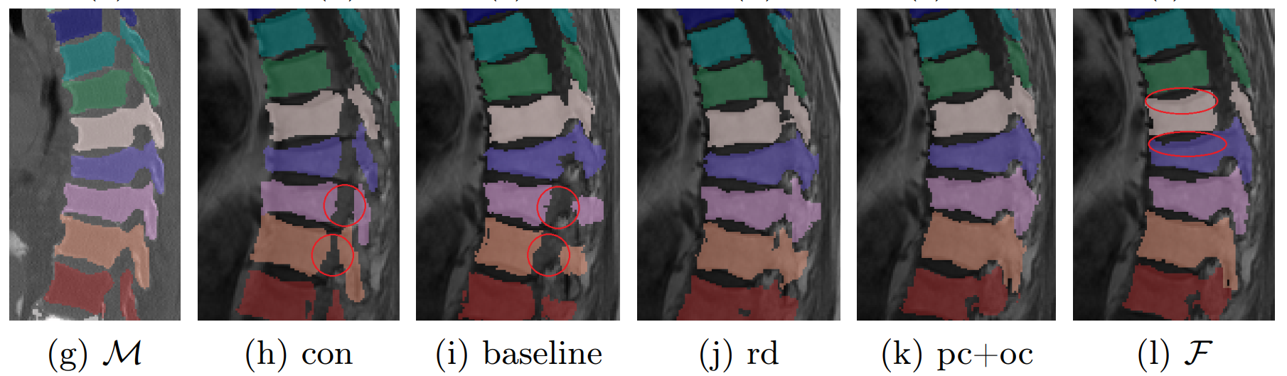
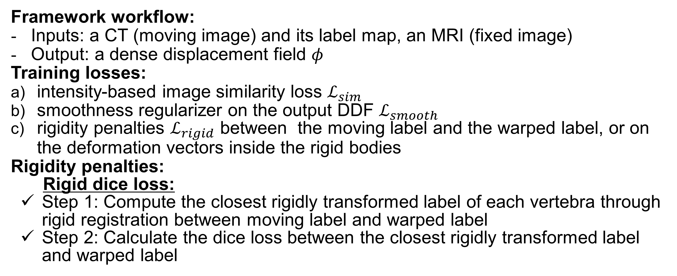
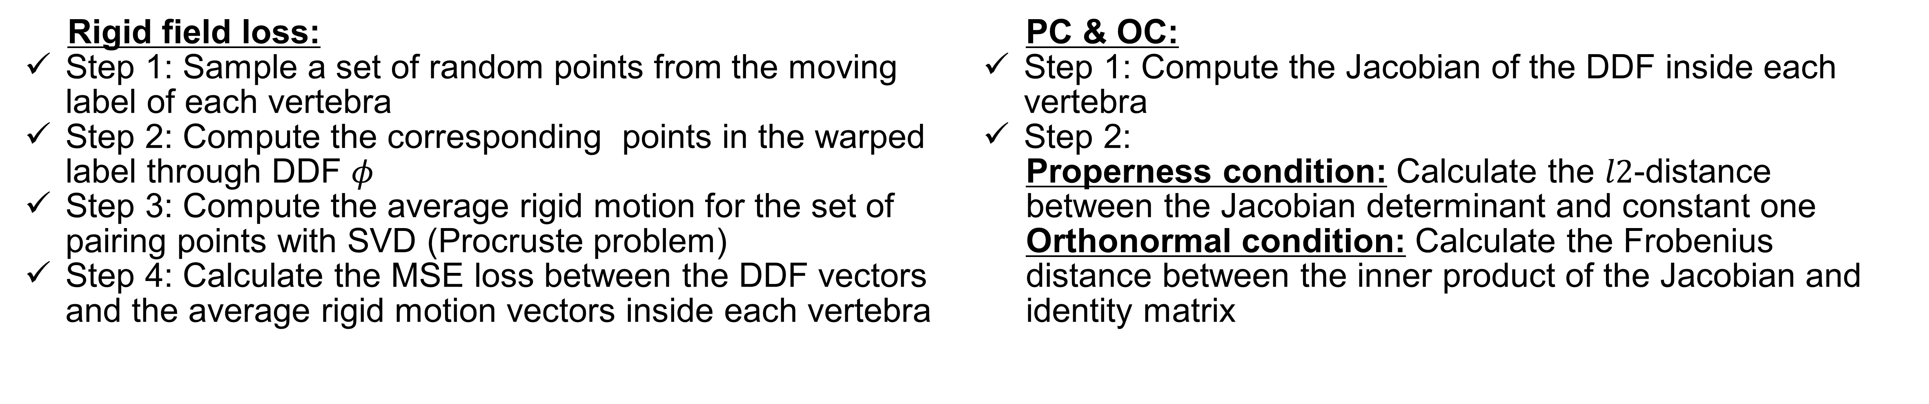
Weakly-supervised Biomechanically-constrained CT/MRI Registration of the Spine
Bailiang Jian^{1,2}, Mohammad Farid Azampour^{1,8}, Francesca De Benetti^{1,2}, Johannes Oberreuter^{1,2}, Christina Bukas^{2,4}, Alexandera S. Gersing^{5,6}, Sarah C. Foreman^{5,6}, Anna-Sophia Dietrich^{5,6}, Jon Rischewski^{5,6}, Jan S. Kirschke^{5,6}, Nassir Navab^{1,7} and Thomas Wendler^{1,2}
¹Chair for Computer Aided Medical Procedures and Augmented Reality, Technische Universität München, Garching, Germany,
² ScintHealth GmbH, Munich, Germany, ³Reply SpA, Munich, Germany, ⁴Helmholtz AI, Helmholtz Zentrum München, Munich, Germany,⁵Department of Radiology, Technische Universität München, Munich, Germany, ⁶Department of Neuroradiology, Technische Universität München, Munich, Germany, ⁷Computer Aided Medical Procedures Lab, Laboratory for Computational Sensing+Robotics, Johns Hopkins University, Baltimore, MD, USA, ⁸Department of Electrical Engineering, Sharif University of Technology, Tehran, Iran
Motivation and Contribution
Clinical motivations:
spinal CT has higher contrast in bony structures
spinal MRI can detect lesions and tumors of the spinal cord, the intervertebral discs and the inner anatomy of the vertebral bodies
Problems in registering articulated rigid structures:
rigid registration cannot address the varying curvature of patients’ spine during different imaging sessions
global deformable registration ignores difference between soft tissues and bony structures
Our contributions:
Proposal of a framework for rigidity-preserving MRI/CT deformable registration of the spine
Introduction of the rigid dice (RD) loss and rigid field (RF) loss for rigidity-preservation
Adaptation of rigidity penalties used in conventional registration (orthonormal condition (OC), properness condition (PC)) to deep learning image registration
Extensive evaluation and ablation study of different losses on an in-house dataset with 167 patients
Proposed Method
Framework workflow:
Inputs: a CT (moving image) and its label map, an MRI (fixed image)
Output: a dense displacement field $φ$
Training losses:
intensity-based image similarity loss $ℒ_{sim}$
smoothness regularizer on the output DDF $ℒ_{smooth}$
rigidity penalties $ℒ_{rigid}$ between the moving label and the warped label, or on the deformation vectors inside the rigid bodies
Rigidity penalties:
Rigid dice loss:
Step 1: Compute the closest rigidly transformed label of each vertebra through rigid registration between moving label and warped label
Step 2: Calculate the dice loss between the closest rigidly transformed label and warped label
Fig 1. An overview of the architecture.
Rigid field loss:
Step 1: Sample a set of random points from the moving label of each vertebra
Step 2: Compute the corresponding points in the warped label through DDF $φ$
Step 3: Compute the average rigid motion for the set of pairing points with SVD (Procruste problem)
Step 4: Calculate the MSE loss between the DDF vectors and the average rigid motion vectors inside each vertebra
PC & OC:
Step 1: Compute the Jacobian of the DDF inside each vertebra
Step 2:
Properness condition: Calculate the $l2$-distance between the Jacobian determinant and constant one
Orthonormal condition: Calculate the Frobenius distance between the inner product of the Jacobian and identity matrix
Results
10
0
Fig 3. Quiver plots of DDF on a sagittal slice of MRI from (a) OC (left) and (b) baseline (right).
Fig 4. Visual examples of different loss settings
Fig 2. Boxplots of different loss settings
PC loss contributes significantly to volume preservation, which is beneficial in bone estimation in vertebroplasty or kyphoplasty.
RD loss achieves the highest level of rigidity (5.7% improvement over baseline), and maintains the details in the process area. It is useful when the image shape should match perfectly, e.g., surgical planning.
RF loss is a suitable choice when the feasibility of the transformation is more important, e.g., in differential diagnostics.
OC loss has more consistent displacements inside vertebra area than baseline method. Training with OC loss also decreases PC loss.

